Slide 1

Food Project Guidance – Southwark
Southwark Food Action Alliance
October 2024

Slide 2
Information/guidance for food projects in Southwark
This is a guide to help people/groups setting up new food projects in Southwark.
One of our long-term aims is to see a Southwark where people are not reliant on charitable food aid.
We therefore encourage “beyond the food bank” projects that provide holistic support for individuals, working with them to address underlying issues and build resilience.
We also encourage and support food projects that contribute to our Sustainable Food Strategy vision and work towards a more sustainable food system for Southwark.

Slide 3
Are you a member of the Southwark Food Action Alliance (SFAA)?
It’s free to become a member - benefits include monthly newsletters, training, access to resources, collaboration, networking, support and peer-to-peer learning.
Email sfaa@pecan.org.uk to join.

Slide 4

Have you notified the Council’s Food Safety Team that you are operating?
You can notify them by emailing: food@southwark.gov.uk
Southwark Council also have useful videos on food safety and hygiene here.
We also recommend project staff and regular volunteers handling food undertake Level 2 Food Safety and Hygiene training.

Slide 5
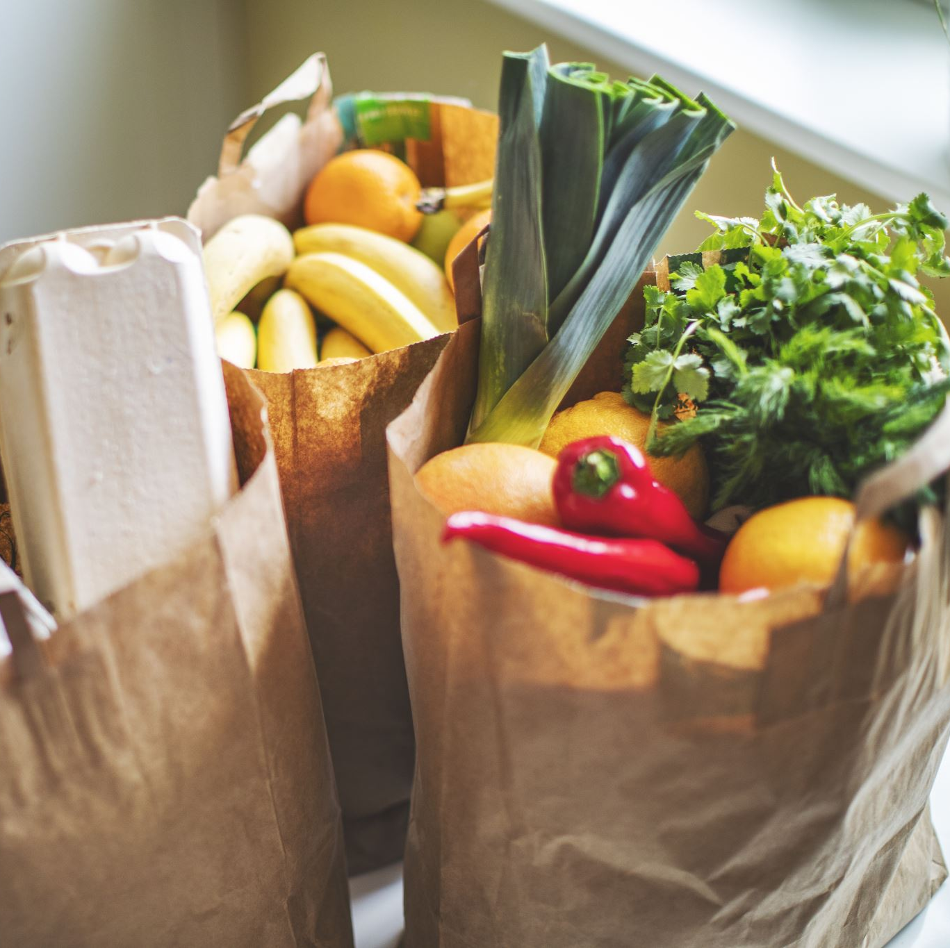
Do you need support in accessing food?
You could try the FareShare Go app. It is free to use. Local supermarkets will list everyday if they have surplus food that a food bank can collect.
Linking with other local food hubs/banks could be a good way to share food and prevent duplication. All food hubs/banks are listed on the SFAA Map.
There are also other organisations who supply food, listed in the Growing Community Food Enterprises toolkit here.

Slide 6

Do you need guidance on setting up your food project?
Sustain has developed a toolkit, Growing Community Food Enterprises. This toolkit was produced as part of Sustain’s Connecting Community Food Enterprises project and aims to support community food projects to develop more sustainably, with tips, tools and guidance. If you are just starting out, it will be helpful to read through the toolkit and learn more about the different models of food support.
Feeding Britain also have best practice guides and case studies on practical interventions and projects which tackle hunger on their website.

Slide 7
Do you need guidance on setting up your food project?
If you are looking to set up a community meal/cooking project:
National Food Service London has a handbook you can access here
FoodCycle Lewisham has a guide here and here
Food for Life has a video here
For growing/gardening projects, Southwark Council has officers dedicated to supporting community gardens in the borough. You can subscribe to their newsletter via CommunityGardening@southwark.gov.uk

Slide 8
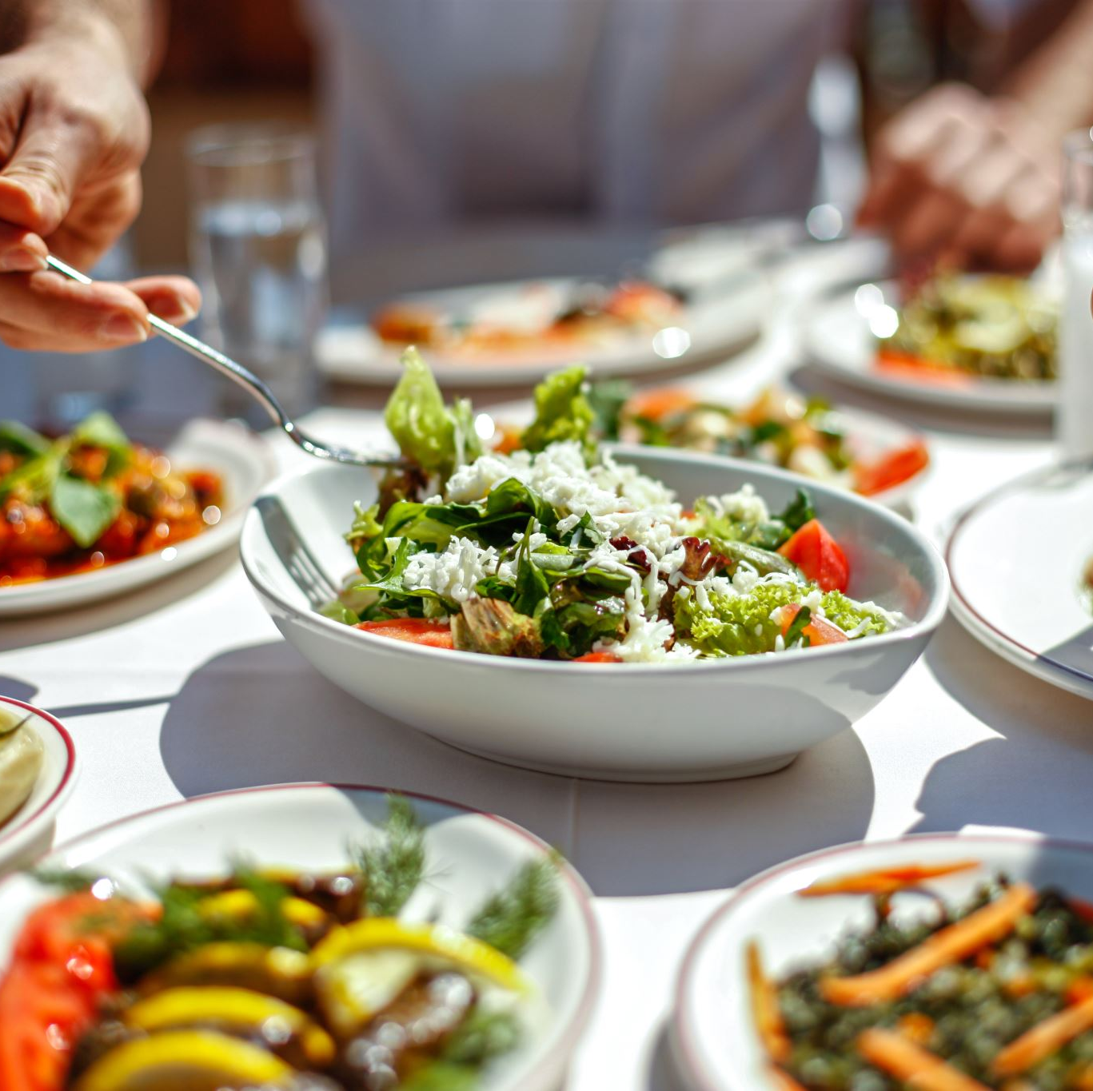
Things to consider when running a community food project
Tips for getting started

Slide 9
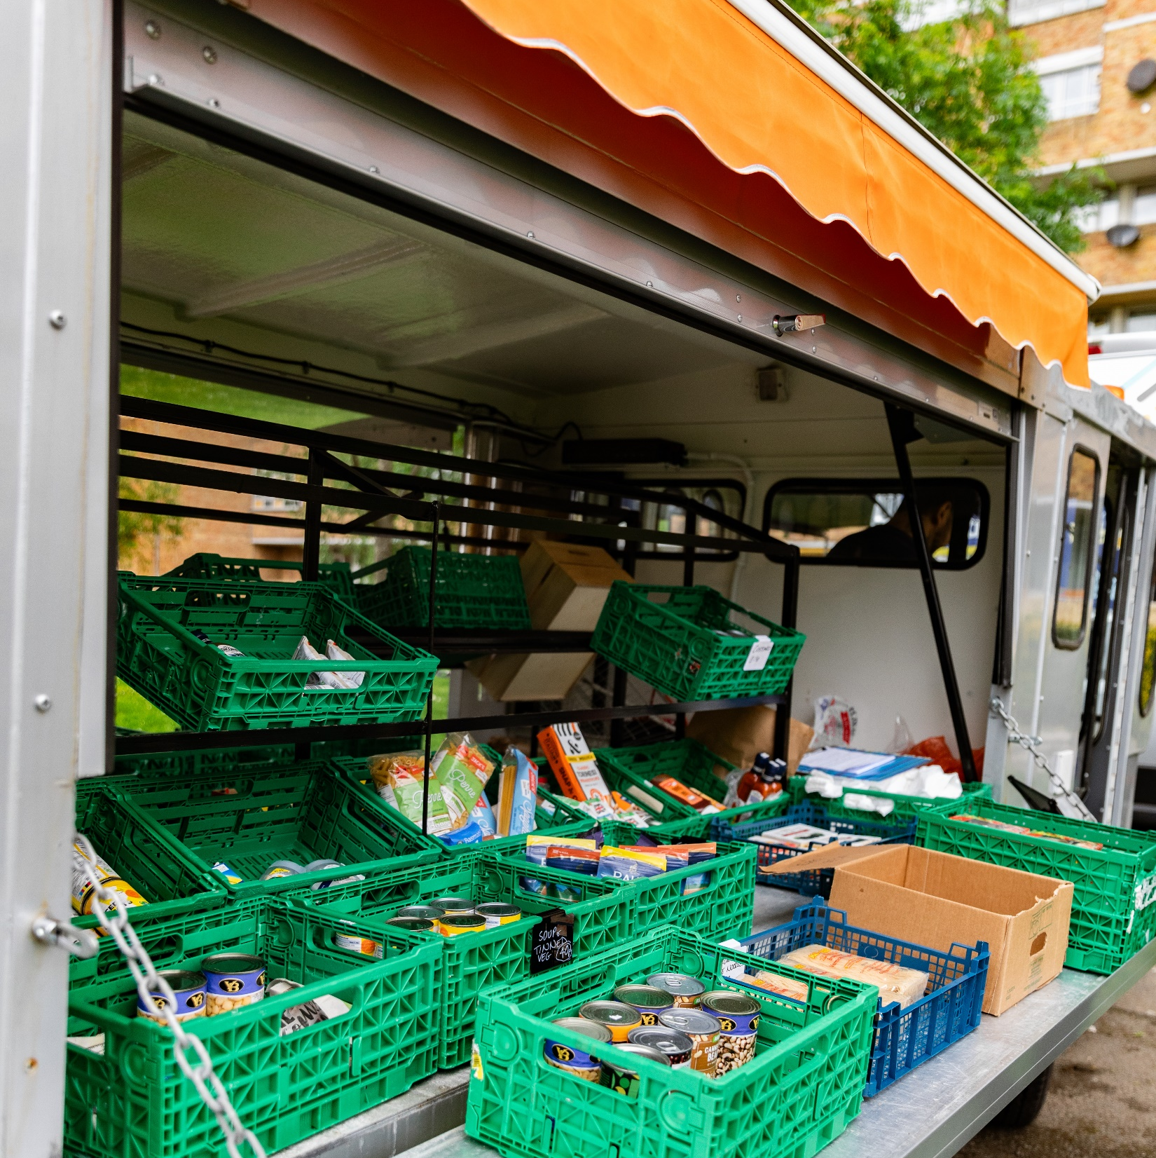
Are there any other food banks/projects near you?
We encourage you to take a look at our SFAA food map, which will show you many of the other free food and meal projects in Southwark near you.
Is your project different to other nearby projects? Or could you collaborate with or support another project?

Slide 10
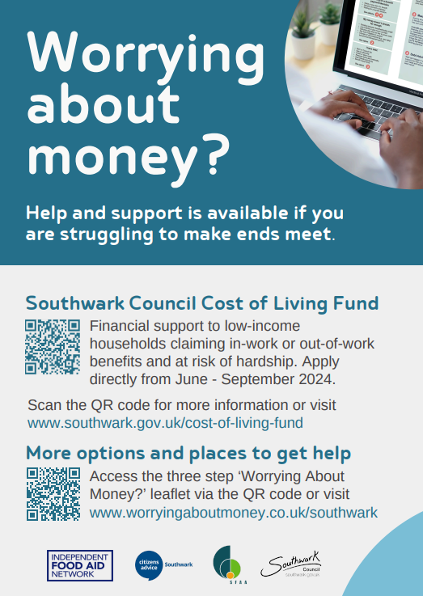
Do you have wraparound support in place, so that residents do not need to rely long-term on food parcels?
For example, can you signpost to financial or debt support services or do you provide any other services that address people’s needs?
Here are some useful links:
Benefits and financial support – Southwark Council
Southwark Emergency Support Scheme - help if you're a Southwark resident who is facing a crisis, emergency or disaster and needs help.
Southwark Council Cost of Living Support - information from Southwark Council about a wide range of services, organisations and grants that may be able to help if you are struggling financially due to the cost of living crisis.
Benefit support – Southwark Council information on benefits.

Slide 11
Do you have wraparound support in place, so that residents do not need to rely long-term on food parcels?
Benefits and financial support – Other
Citizen’s Advice - independent organisation specialising in confidential information and advice to assist people with legal, debt, consumer, housing and other problems in the United Kingdom
IFAN’s Worrying About Money leaflet - advice and support to maximise income through local resources
Money Helper – national money advice website run by Money Advice Service

Slide 12
Do you have wraparound support in place, so that residents do not need to rely long-term on food parcels?
Health and Wellbeing
Healthy Start – NHS scheme that helps women who are pregnant or have young children and are receiving benefits, buy foods such as milk or fruit
Southwark’s food and fun holiday programme – information on school holiday activity and food programme for children aged four to 16 on benefits-related free school meals
Southwark Wellbeing Hub - provides information and support to anyone in Southwark who would like to improve their mental health and wellbeing
Southwark Children and Family Centres – information on children and family centres in Southwark which provide advice and support for parents and carers

Slide 13
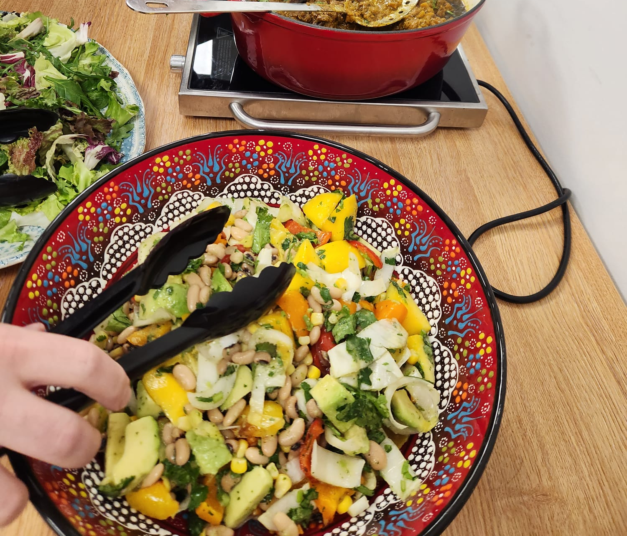
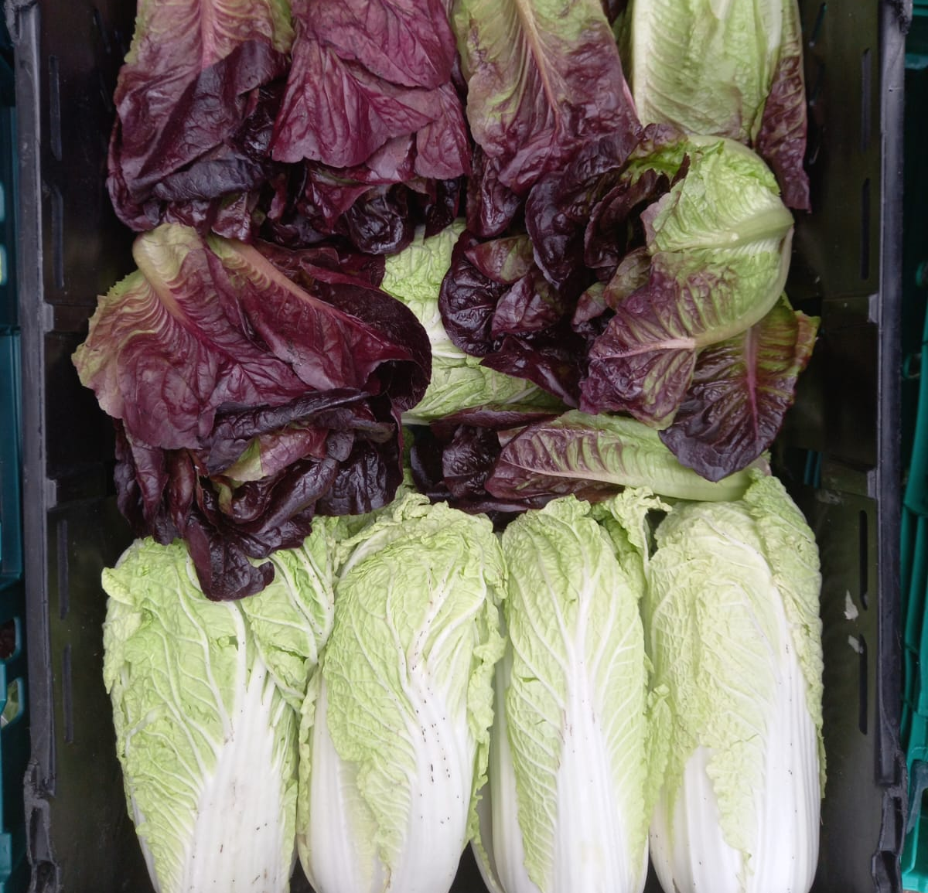
What could you do to ensure that food parcels/meals are healthy and culturally appropriate?
Do you have information on healthy diets?
Do you provide any culturally appropriate foods?

Slide 14
How do you support people with disabilities to access your service?
E.g. Do you have “quiet times” available?
Do you have a ramp or a lift to assist wheelchair users?

Slide 15
Do you have an eligibility criteria?
E.g. are there any income requirements in place?
Do you only assist Southwark residents?

Slide 16
Do you have a safeguarding policy in place?
Example safeguarding policies can be found here
The Southwark Safeguarding Children Partnership and the Southwark Safeguarding Adults Board provide free multi-agency safeguarding training for all staff, volunteers and community leaders who work directly with children, parents and carers, and vulnerable adults in the borough

Slide 17
What are your processes for volunteering recruitment and management?
Community Southwark (umbrella body for the voluntary and community sector in Southwark) have lots of information and support for volunteer coordination and management
The National Council for Voluntary Organisations also have guidance and support on volunteers (with free guidance for small charities here)

Slide 18
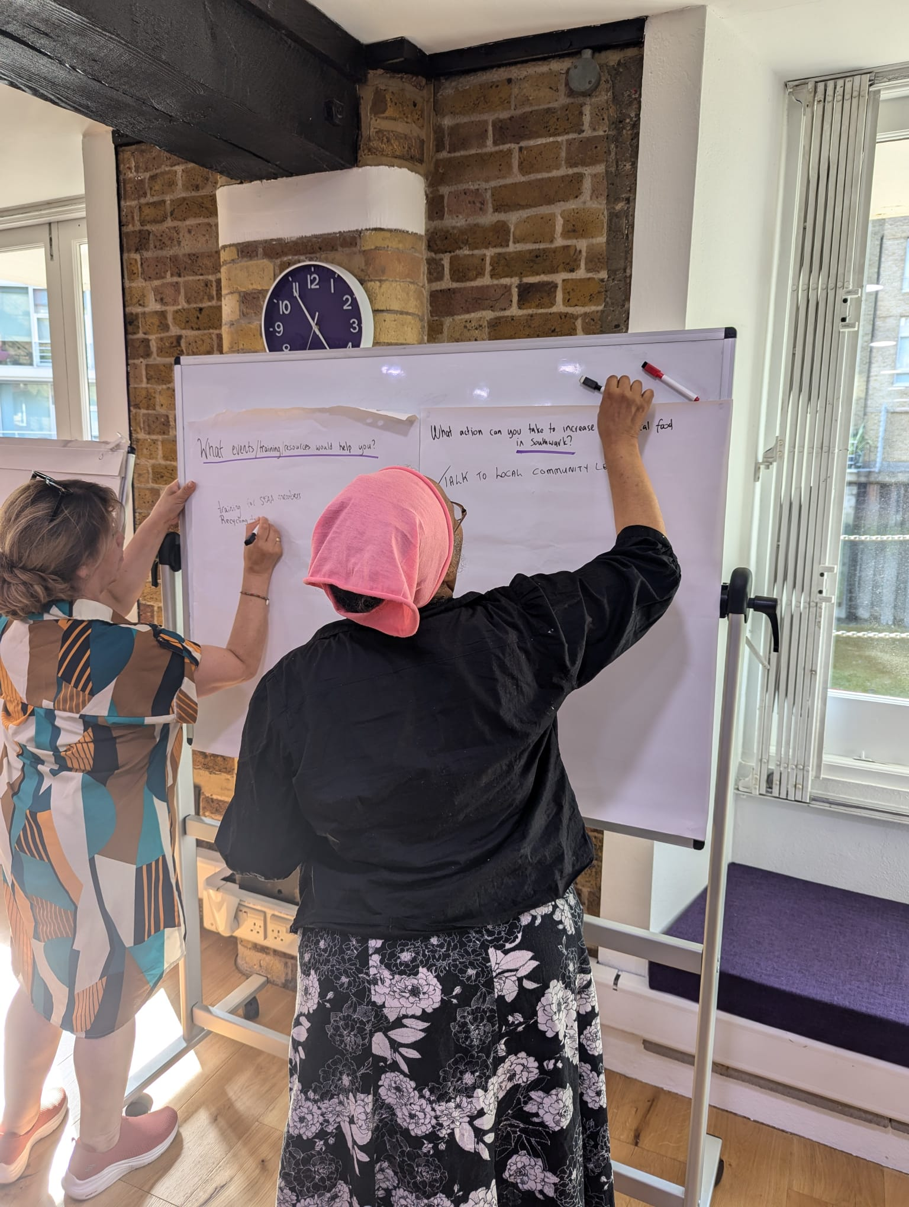
Do your staff and volunteers have training working with clients?
Southwark Council run various free trainings for Southwark VCS organisations such as Make Every Contact Count and Mental Health First Aid – information is available via SFAA
Samaritans run various trainings, including working with vulnerable clients (paid training) – link here

Slide 19
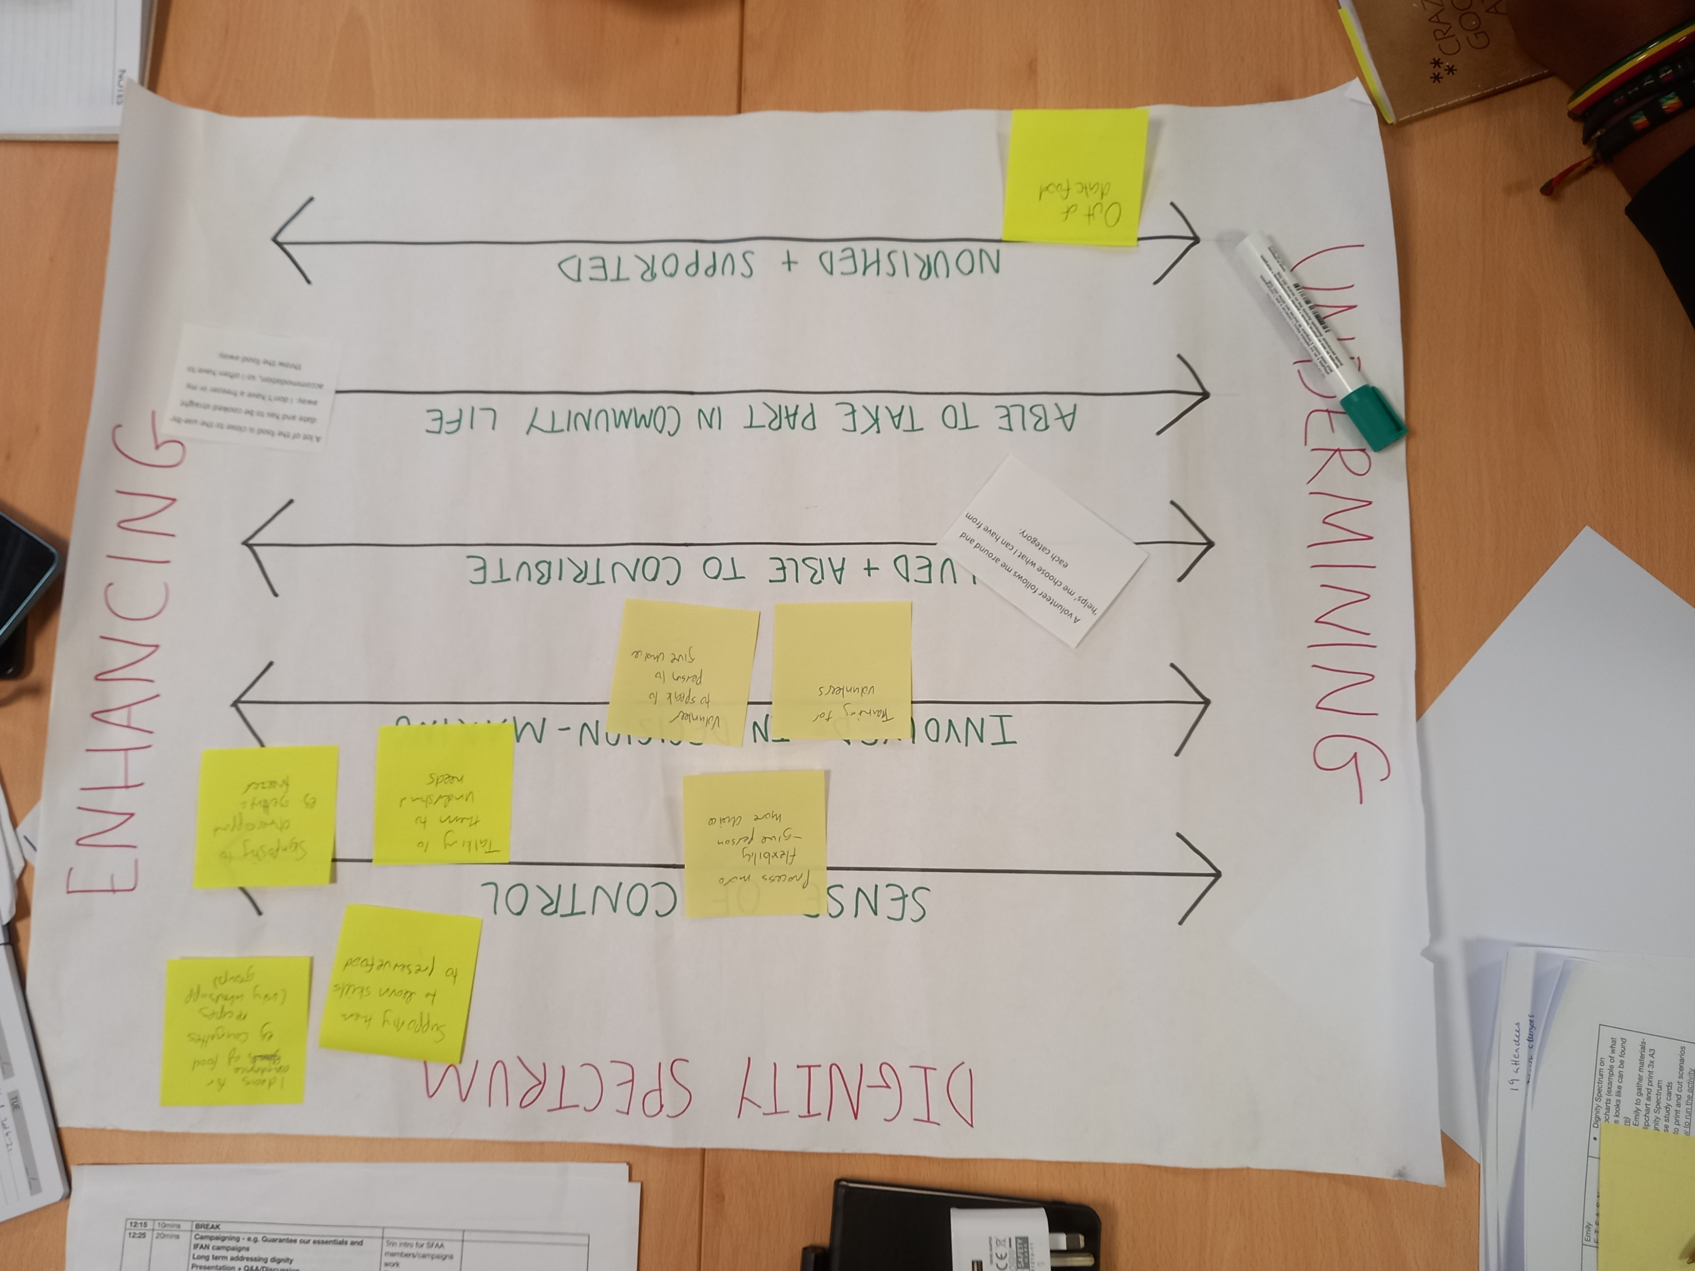
Is dignity embedded into the design and practice?
You can learn more about dignity in food provisions here. SFAA provide dignity training throughout the year, email sfaa@pecan.org.uk and sign up to the SFAA newsletter for more information.
Further information on Dignity can be found on the Dignity in Practice principles website here and the Alliance for Dignified support here.

Slide 20

Dignity Principles
Service users should:
Feel a sense of control: having power to make choices about what, where, when, how and with whom you eat.
Be able to take part in community life: feeling able and welcome to take part in different aspects of community life, regardless of your financial situation.
Be nourished and supported: being able to enjoy food and access support that meets your needs.
Be involved in decision-making: feeling able to share your views and ideas and to have those views taken seriously in decision-making.
Feel valued and able to contribute: feeling recognised and valued as a whole person with knowledge, skills and experiences to share.

Slide 21
Thank you!
For any other questions or assistance, please contact sfaa@pecan.org.uk.

