Slide 1

Signposting for food projects: Southwark
Southwark Food Action Alliance
September 2025

Slide 2
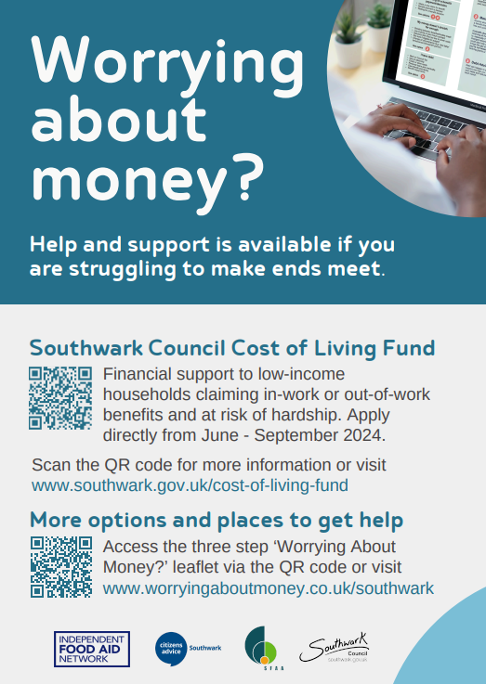
Do you have wraparound support in place, so that residents do not need to rely long-term on food parcels?
For example, can you signpost to financial or debt support services or do you provide any other services that address people’s needs?
Here are some useful links:
Benefits and financial support – Southwark Council
Southwark Emergency Support Scheme - help if you're a Southwark resident who is facing a crisis, emergency or disaster and needs help.
Southwark Council Cost of Living Support - information from Southwark Council about a wide range of services, organisations and grants that may be able to help if you are struggling financially due to the cost of living crisis.
Benefit support – Southwark Council information on benefits.

Slide 3
Do you have wraparound support in place, so that residents do not need to rely long-term on food parcels?
Benefits and financial support – Other
Citizen’s Advice - independent organisation specialising in confidential information and advice to assist people with legal, debt, consumer, housing and other problems in the United Kingdom
IFAN’s Worrying About Money leaflet - advice and support to maximise income through local resources
Money Helper – national money advice website run by Money Advice Service

Slide 4
Do you have wraparound support in place, so that residents do not need to rely long-term on food parcels?
Where to get debt advice
Stepchange: 0800 138 1111 or stepchange.org
National Debtline: 0808 808 4000 or nationaldebtline.org
Debt Free Advice: 0800 808 5700
Citizen’s advice

Slide 5
Do you have wraparound support in place, so that residents do not need to rely long-term on food parcels?
Health and Wellbeing
Healthy Start – NHS scheme that helps women who are pregnant or have young children and are receiving benefits, buy foods such as milk or fruit
Southwark’s food and fun holiday programme – information on school holiday activity and food programme for children aged four to 16 on benefits-related free school meals
Southwark Wellbeing Hub - provides information and support to anyone in Southwark who would like to improve their mental health and wellbeing
Southwark Children and Family Centres – information on children and family centres in Southwark which provide advice and support for parents and carers

Slide 6
Do people need help with employment problems?
ACAS - Free advice on employment rights
The Equality Advisory & Support Service (EASS) - Assists individuals on issues relating to equality and human rights, Helpline 0808 800 0082
Guidance from Citizen’s Advice

Slide 7
Do you have information and support for older people?
Southwark Council Directory of services for adults 50+:
https://www.southwark.gov.uk/sites/default/files/2025-02/Healthy%20ageing%20guide.pdf
Southwark Charities - grants guide for older adults:
https://www.southwarkcharities.co.uk/wp-content/uploads/2025/01/Grants-to-individual-older-people-in-Southwark-2025.pdf

Slide 8
Are you aware of support for LGBTQ+?
The Africa Centre now hosts African Rainbow Family (who moved from the Outside Project as they’ve grown significantly in the last year)
Less outreach oriented, but in terms of social spaces there’s also The Rising, John the Unicorn and Betty and Joans; worth noting that drag/party /cruising hotspots can also be good outreach spaces for queer people in crisis especially hidden homeless who are using them for sex work and sofa surfing – please see here for an example of outreach around shelter that The Outside Project did with Westminster in LGBTQ+ nightlight venues (posters went above urinals), don’t know if there could be an equivalent re: food insecurity
The Cinema Museum indirectly has acted as a hub particularly for older trans people in Lambeth/Southwark, it has historically hosted the London Trans Film Festival and a trans women’s coffee morning

Slide 9
Are you aware of support for LGBTQ+?
London LGBTQ+ Centre, which also runs a café operating accessible pricing and a ‘pay it forward’ scheme (I don’t know if this qualifies them for your map?)
The Outside Project, who also have a food element in that they normally run a weekly free ‘café’ on a Tuesday called Café Queero; but they have currently had to pause this. They hope to resume this year so keep an eye out
CliniQ in Camberwell who act as a big social outreach touchstone for the south London trans community

Slide 10
Can you signpost people to mental health support?
Mental Health Information Service for Lambeth and Southwark
The service is open Monday to Friday, 9am – 5 pm
Ring: 020 8159 8355
Email: infols@selmind.org.uk
Webform: https://selmind.org.uk/mental-health-information-service/
There is also an online directory of over 600 resources at the link above.
Southwark Wellbeing Hub
https://www.together-uk.org/southwark-wellbeing-hub/
Southwark Wellbeing Hub takes the stress out of finding, choosing and receiving support.
We provide information and support to anyone in Southwark who would like to improve their mental health and wellbeing. The Hub’s services are free and open to anyone who lives in Southwark or is registered with a Southwark GP.

Slide 11
Are you aware of migrant support services in London?
Unity Project for help with applying to change No Recourse to Public Funds conditions
Kings Immigration and Asylum Clinic for free legal advice
Coram Children’s Legal Centre has free legal information, advice and representation for children, young people, families and carers.
Project for the Registration of Children as British Citizens (PRCBC) has free legal advice for registering children and young people as British citizens .
Rights of Women advice on family, criminal and immigration issues and provides free confidential legal advice and information to women.
Migrant legal Action: https://advicefinder.turn2us.org.uk/Home/Details/1531
Migrant helpline

Slide 12
Are you aware of support services for domestic violence?
National Domestic Abuse Helpline for Women
0808 2000 247 –refuge spaces and safety planning
Refuge.org.uk
WomensAid.org.uk
Galop LGBT+ helpline 0800 999 5428
Rights of Women: 020 7251 6577
Respect Men’s Advice Line: 0808 8010327

Slide 13
Do you need Housing Advice – eviction and homelessness?
Shelter: London Helplines
0344 515 1540 (25+)
0330 053 6091 (Under 25)
Civil Legal Advice
0345 345 4 345. You might be able to get legal aid if you cannot afford to pay legal costs.
Find your local Law Centre – Cambridge House/Southwark Law Centre please telephone us on 020 7732 2008 Monday to Friday 9.30-1 & 2-5.30

Slide 14
Do you need local resources for homeless people?
Streetlink: help people sleeping rough in London
Use Homeless Link to refer to hostels
The Manna Society
Shelter – where to stay if homeless and on streets

Slide 15
Do you need help with energy bills, fuel, heating or water?
London Green Doctors – free energy advice
Shine – fuel poverty and free energy advice
South East London Community Energy (SELCE) – energy advice
Citizen’s Advice has guidance on getting energy advice and grants to help pay your energy bills and advice on your water bill
WaterHelp scheme and WaterSure bill cap can reduce payments

Slide 16
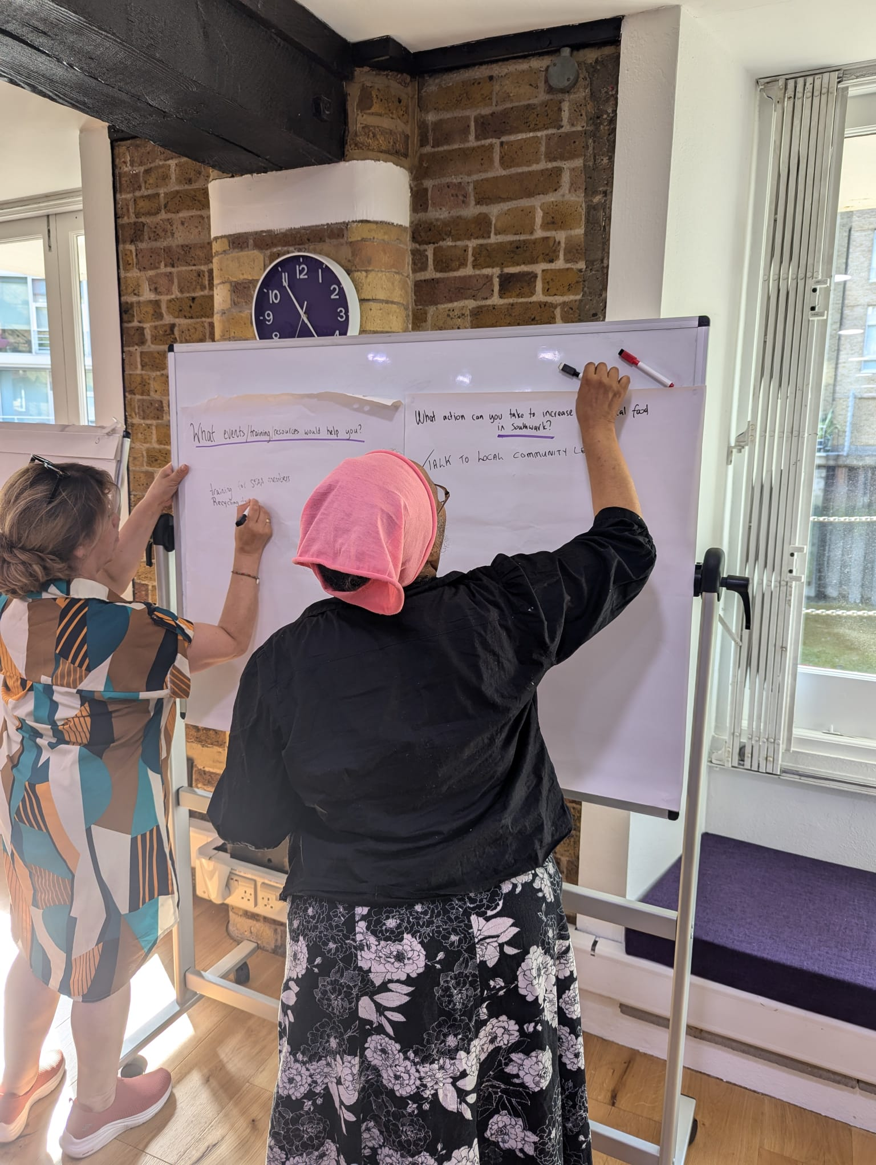
Do your staff and volunteers have training working with clients?
Southwark Council run various free trainings for Southwark VCS organisations such as Make Every Contact Count and Mental Health First Aid – information is available via SFAA
Samaritans run various trainings, including working with vulnerable clients (paid training) – link here

Slide 17
Thank you!
For any other questions or assistance, please contact sfaa@pecan.org.uk.

